Slide 1
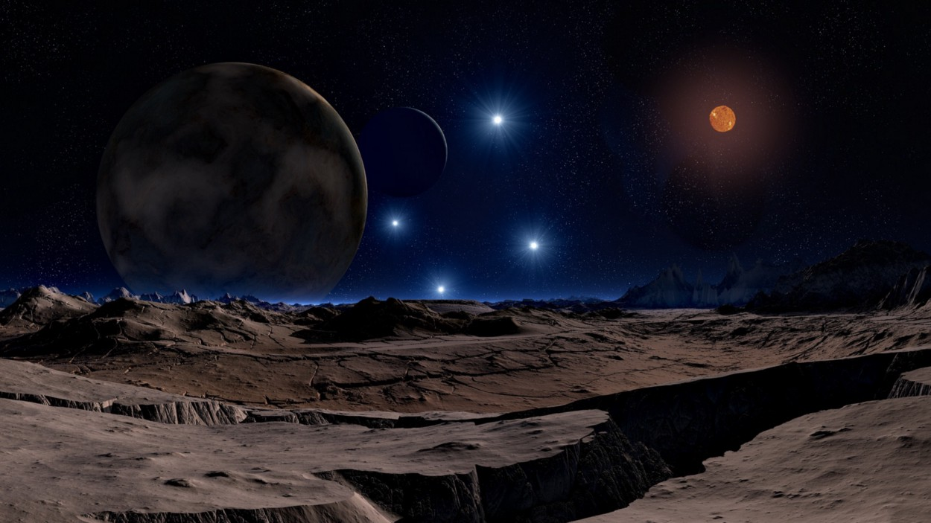
Planet Hunting &
Habitability Detection
Image credit: Lunar Landscape by DasWortewand. CC0 via Pixabay.

Slide 2

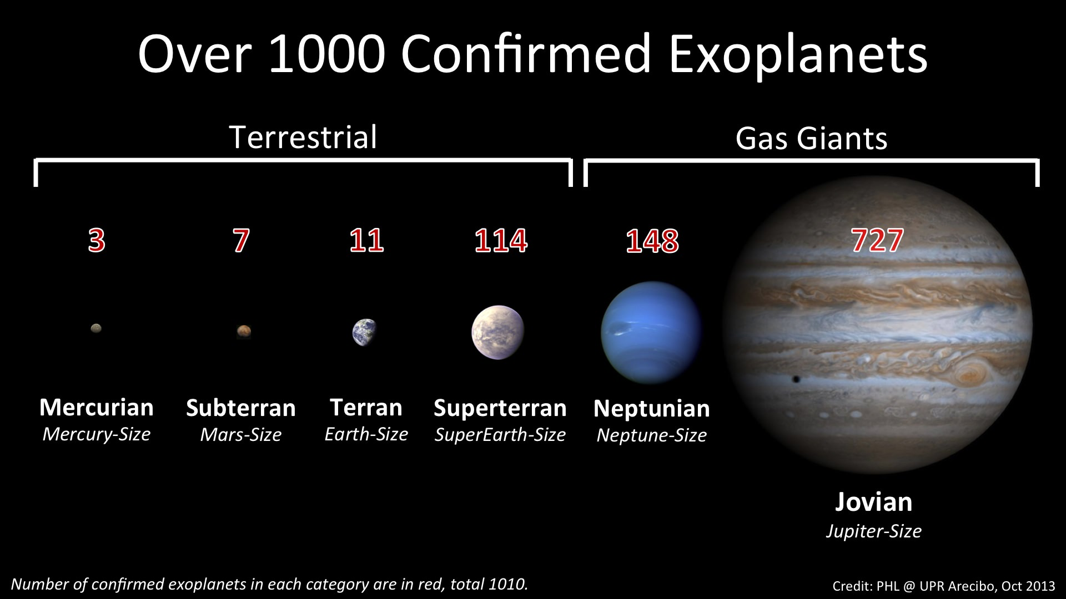

Introductıon
Objectives: I had two objectives when I started the project. One is to measure how effective is machine learning to detect exoplanets. And the other one is to predict whether a planet is habitable or not.
Solution: To accomplish these goals, I used three different datasets. I worked on the Kepler data for goal-1 and PHL-Hec data for goal-2. More info is given in the data knowledge sections.

Slide 3
Goal #1: Planet huntıng
Exoplanet is a planet that orbits a star outside our solar system.
There are two exoplanet missions: Kepler and Tess.
Kepler observed 530,506 stars and discovered 2,662 exoplanets over its lifetime. The continuing mission, Tess discovered 79 confirmed planet and 2,330 candidates until now.

Slide 4
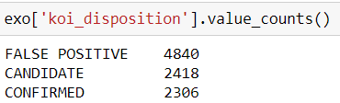
Data & methodology
I extracted the Kepler’s exoplanet data from NASA for my project. Dataset contains 9564 rows with 141 columns.
The columns in this dataset are about stellar’s features but I need time-series flux values for each star to achieve my goal. So, I used the lightcurve package to extract time-series flux data via the kepid.
After gathering flux data, I got a dataset that contains 7888 rows and 1627 columns.

Slide 5
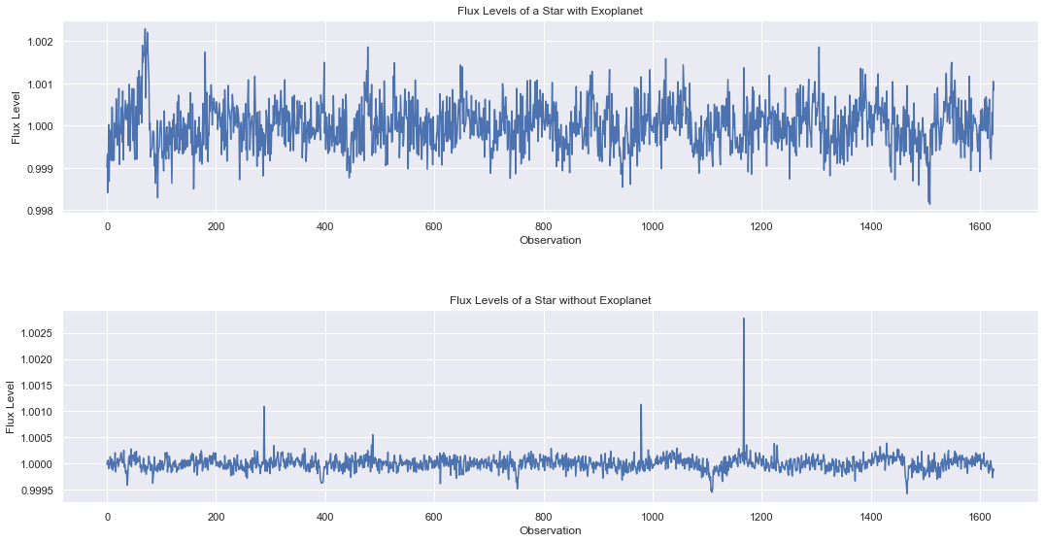
Data & methodology
Flux levels of a star with exoplanet and without exoplanet.

Slide 6
Data & methodology
Set up & Data Gathering
Gathering flux data via lightcurve package.
Load all the arrays and transform them to pandas DataFrame
Visualization
Demonstration of Lightkurve package.
Exoplanets & Non-Exoplanets flux distributions.

Slide 7
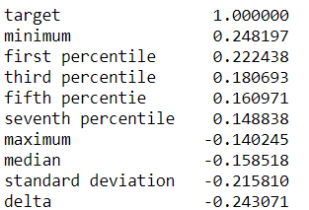
Data & methodology
Feature Engineering
My dataset was time-series and not really appropriate for the classic machine learning algorithms, so I made my own dataset that has more characteristic features to work on.
Machine Learning
Defining machine learning algorithms.
Evaluation & Optimization.

Slide 8
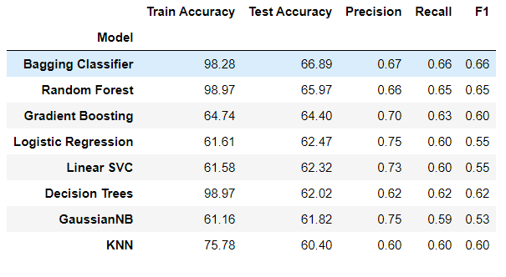
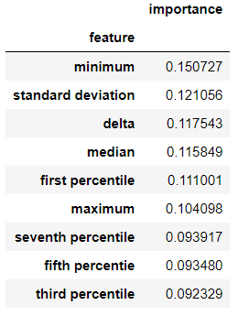
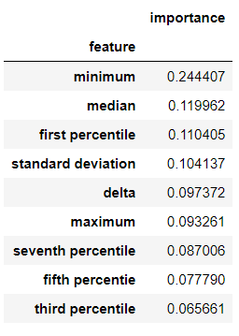
Machıne learnıng
Defined models:
Feature importance tables of random forest and decision tree.

Slide 9
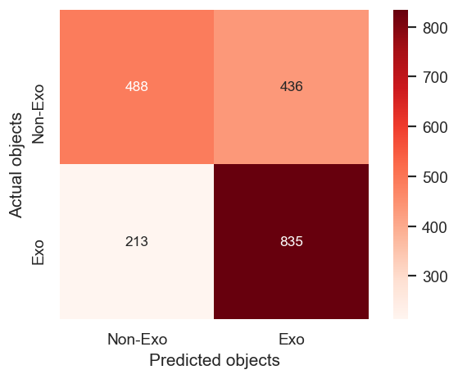
Conclusıons
The best result that I got by defined models is approximately 67% for test accuracy.
I could say M.L models are not so good at hunting for exoplanets. But it isn't complete defeat though.
The biggest factor in determining exoplanet candidacy is the minimum flux according to feature importance tables.

Slide 10
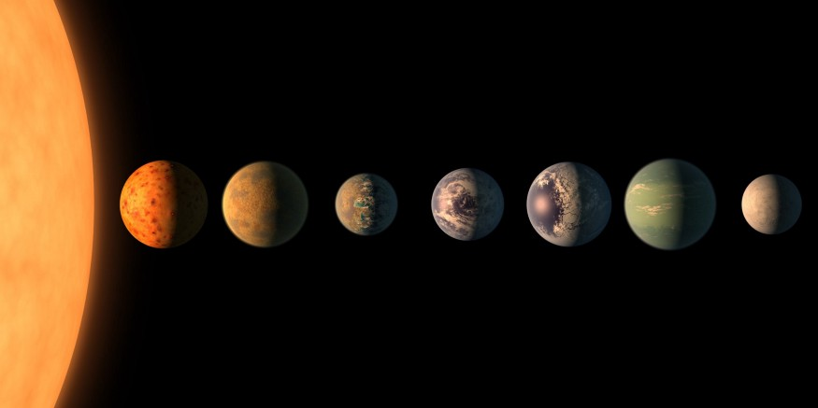
Goal #2: Habıtabılıty detectıon
The main objective of exoplanet research is finding habitable planets in different stellar systems.
I extracted the PHL's Exoplanets Catalog to predict habitable planets. It contains observed and modeled parameters for all currently confirmed exoplanets, including those potentially habitable.
“Somewhere, something incredible is waiting
to be known.” Carl Sagan

Slide 11
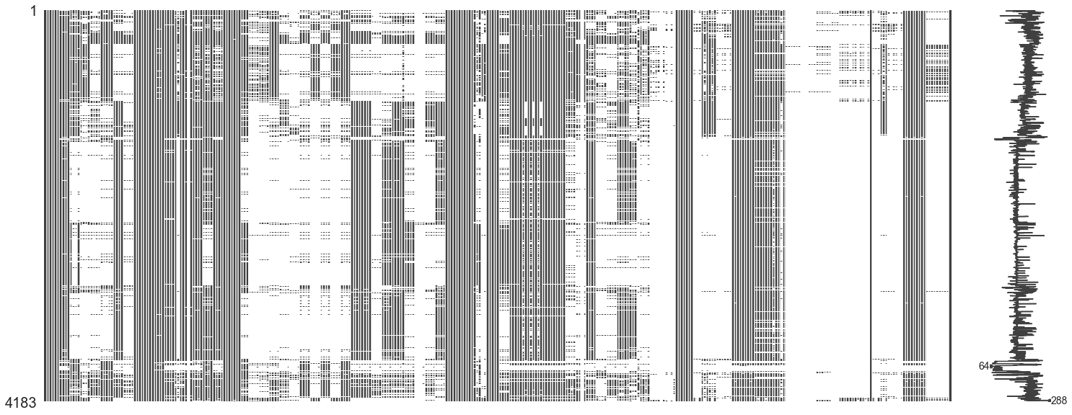
Data knowledge
In my second goal, there are two datasets to handle: Nasa Exoplanet Archive and PHL data which contains habitability situations.
These datasets contain the physical features of planets and stars.
The image that lies on the right is picturing missing values in my main dataset.

Slide 12
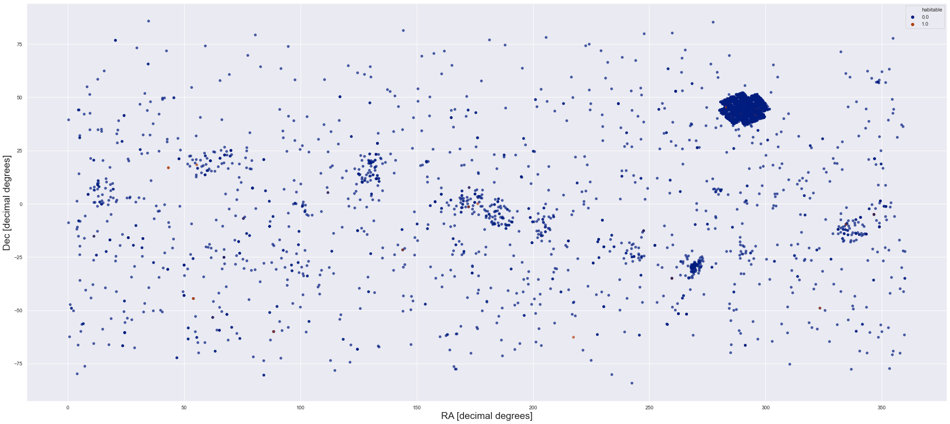
Methodology
The followed methodology in this project is:
Preprocessing and data merging
Handling missing data
EDA/Visualization
Data preparation
SMOTE – Oversampling
Defining machine learning algorithms
Evaluation & Optimization

Slide 13
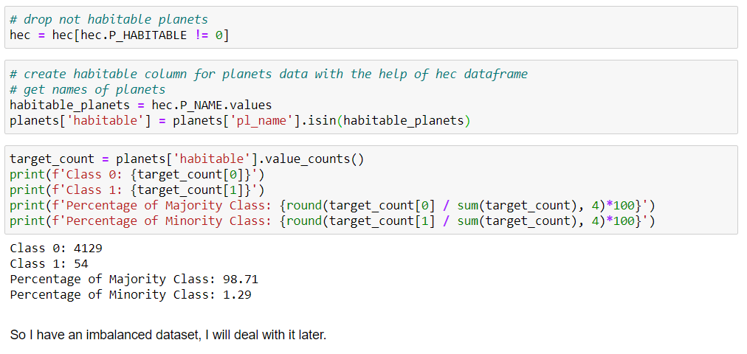
Mergıng the datasets
As I said before, I have two datasets for the project: NASA and PHL data. The exoplanet archive from NASA is my main dataset because it has more features from the observed planets & stars. I also need PHL data to use its habitability feature.

Slide 14
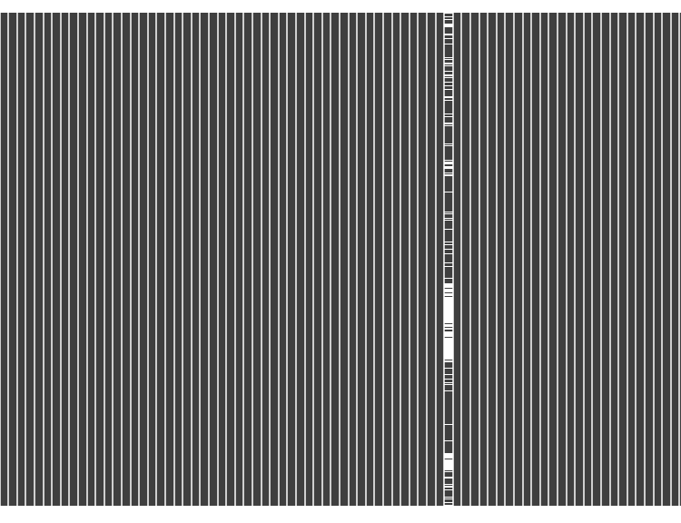
Handlıng mıssıng data
As can be seen in the picture above, I have a lot of missing value in the dataset.
So I followed these steps to solve my problem:
I removed columns with more than 40% missing data.
I removed categorical features with more than 10 unique values.
Iterative imputing on numeric values.
Right picture indicates the missing values after these steps. In the current situation, just two categorical features are left.
I had 131 entries when this step was completed.

Slide 15
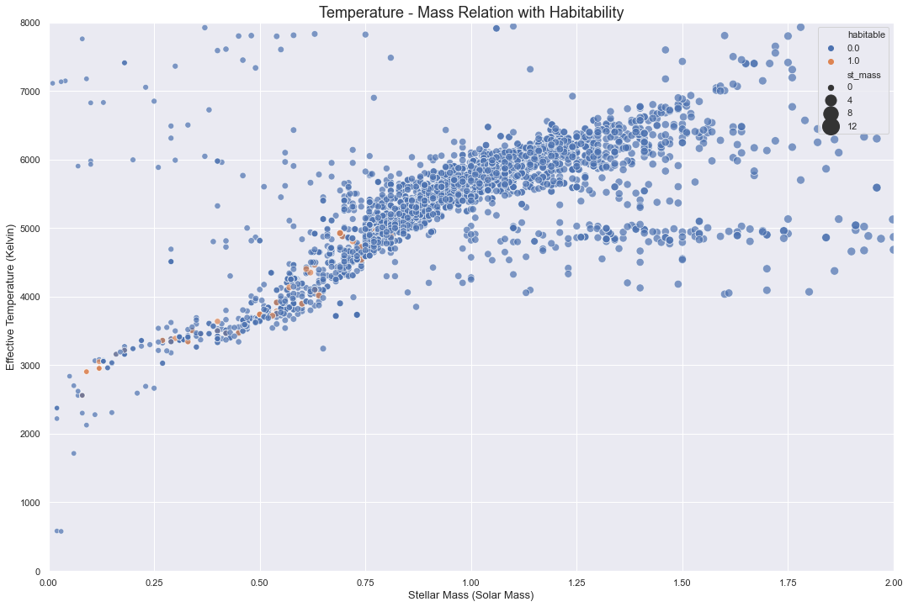

Slide 16
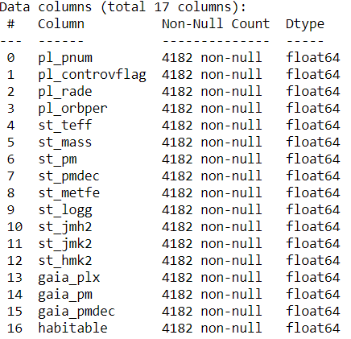
Headıng to machıne learnıng
Data Preparation:
Dropping lowly correlated features & selecting highly correlated features for model's dataset.
After some research, I decided to add these features to model's dataset: planet mass, planet's radial velocity amplitude [m/s], equilibrium temperature [K],planet radius [Earth radii], and orbital period [days]. But I have just planet radius and orbital period, there are so many missing data in the other features.
Normalization & logarithmic transformations.
SMOTE – Oversampling

Slide 17
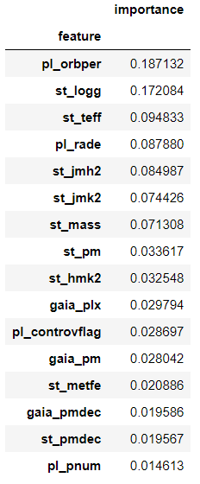
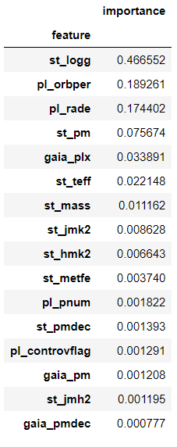
Headıng to machıne learnıng
Defined models:
Logistic Regression
KNN
Linear SVC
Naive Bayes
Decision Trees
Random Forest
Voting Classifier
AdaBoost
Stochastic Gradient Boosting
XGBoost
Random Forest Decision Tree

Slide 18
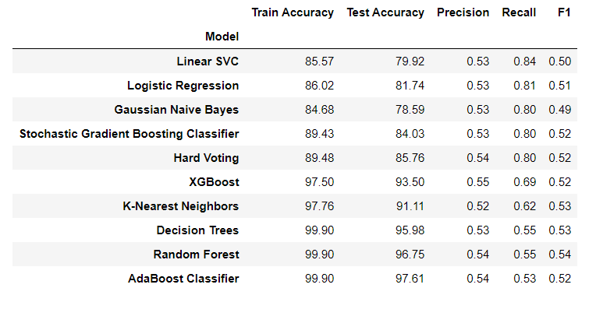
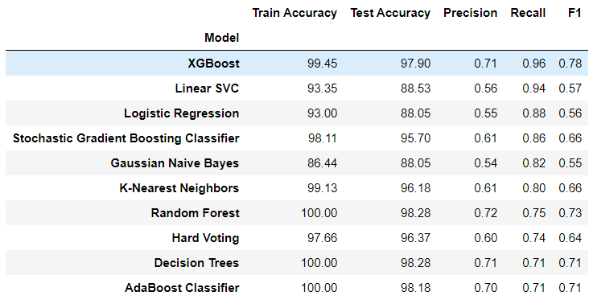
evaluatıon
Performance differences between the two different models set. The second one contains ‘planet radius’ and ‘orbital periods’ features.

Slide 19
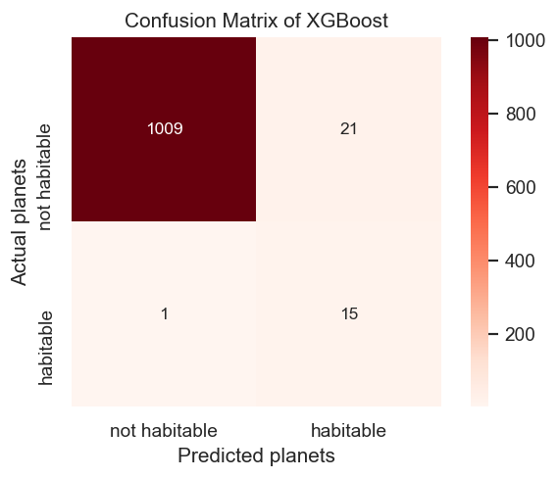
Conclusıons
Features like planet Radius, orbital days, stellar surface gravity, and stellar surface temp have a significant impact on the model.
XGBoost is really successful in the task. The model predicted all exoplanets except one.

Slide 20
Further Workıngs
For goal #1:
To include TESS data in the project.
A visual recognition model could be added.
Research to enrich features.
For goal #2:
Finding most important features for habitability via NLP work on academic papers.
Adding chemical features if it is possible.

Slide 21

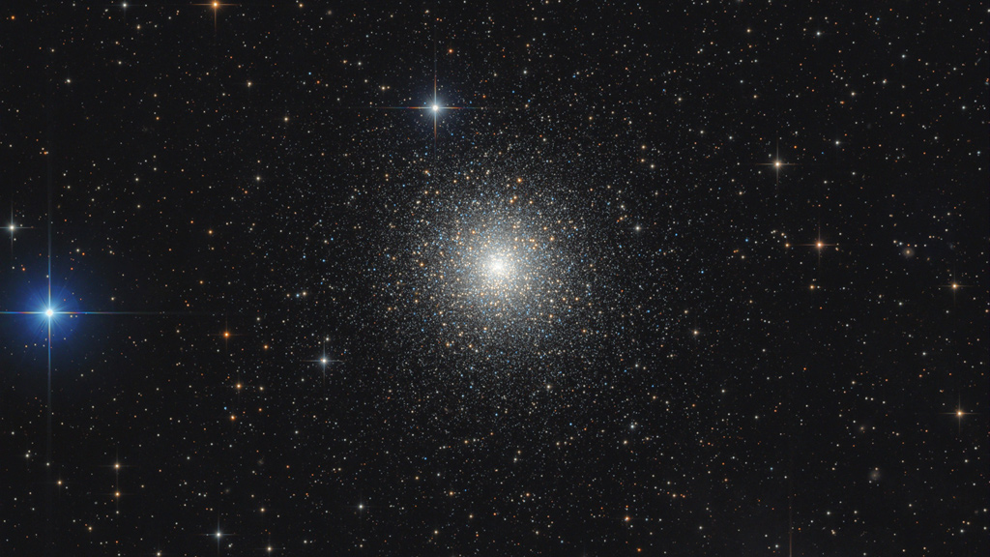

Thank you

